Slide 1
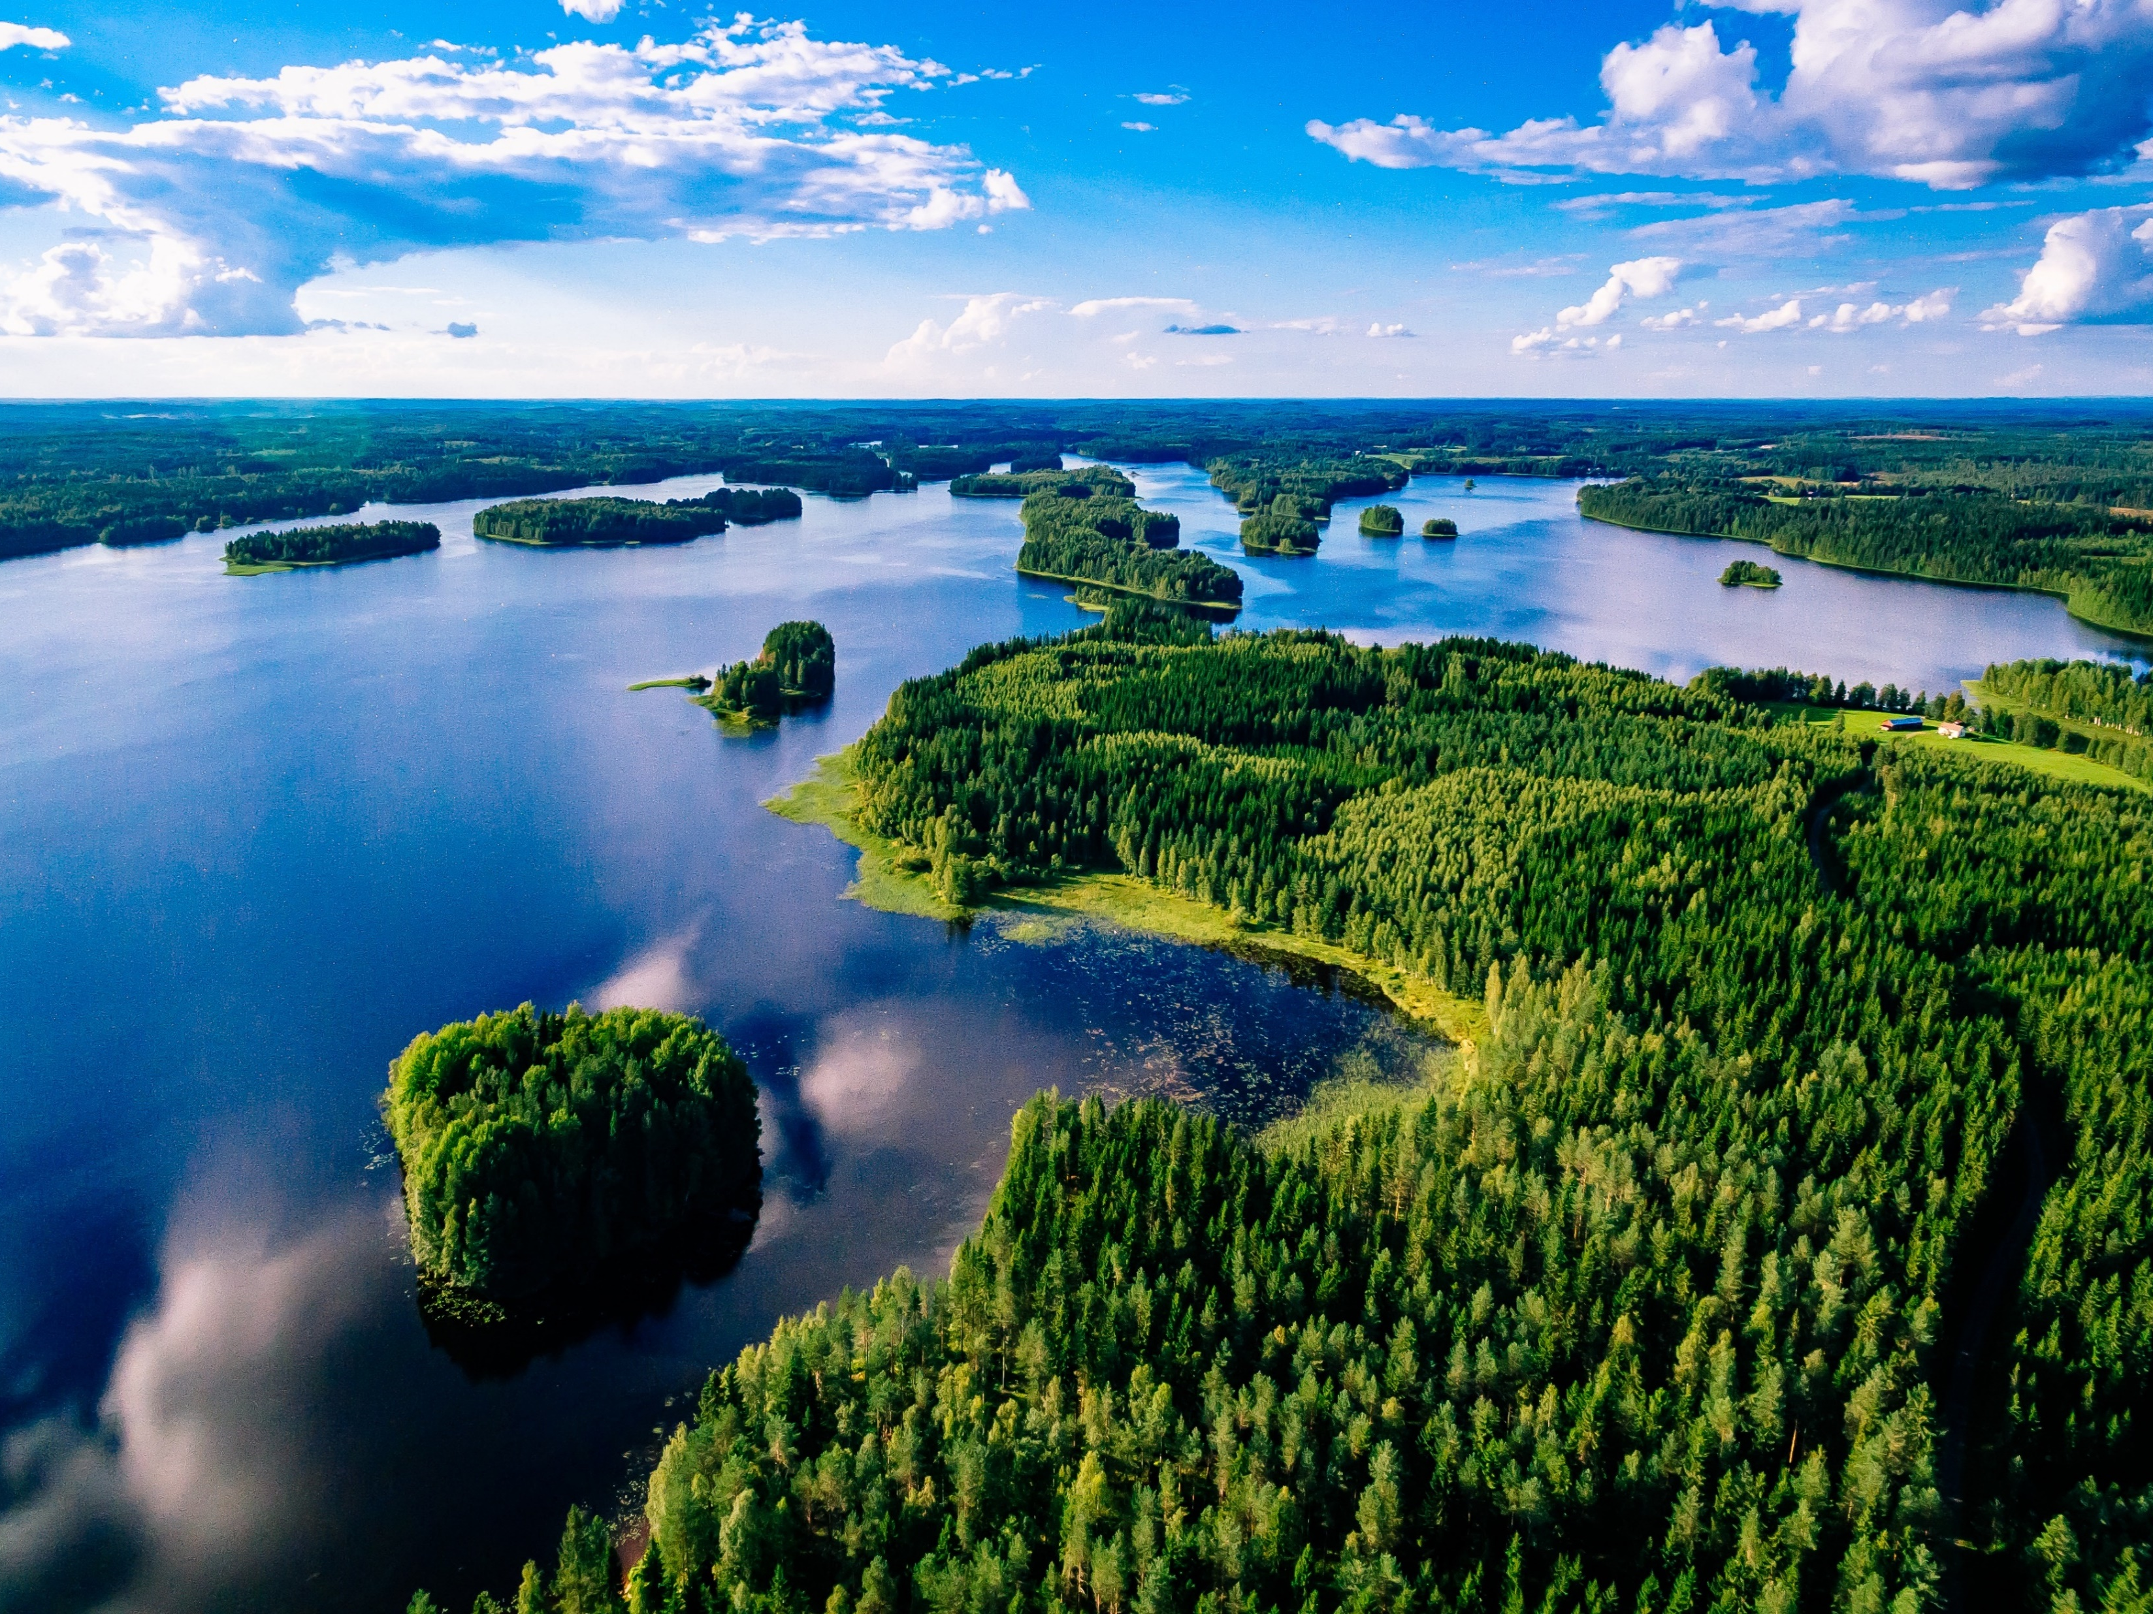
Finland Expedition 2026

Slide 2
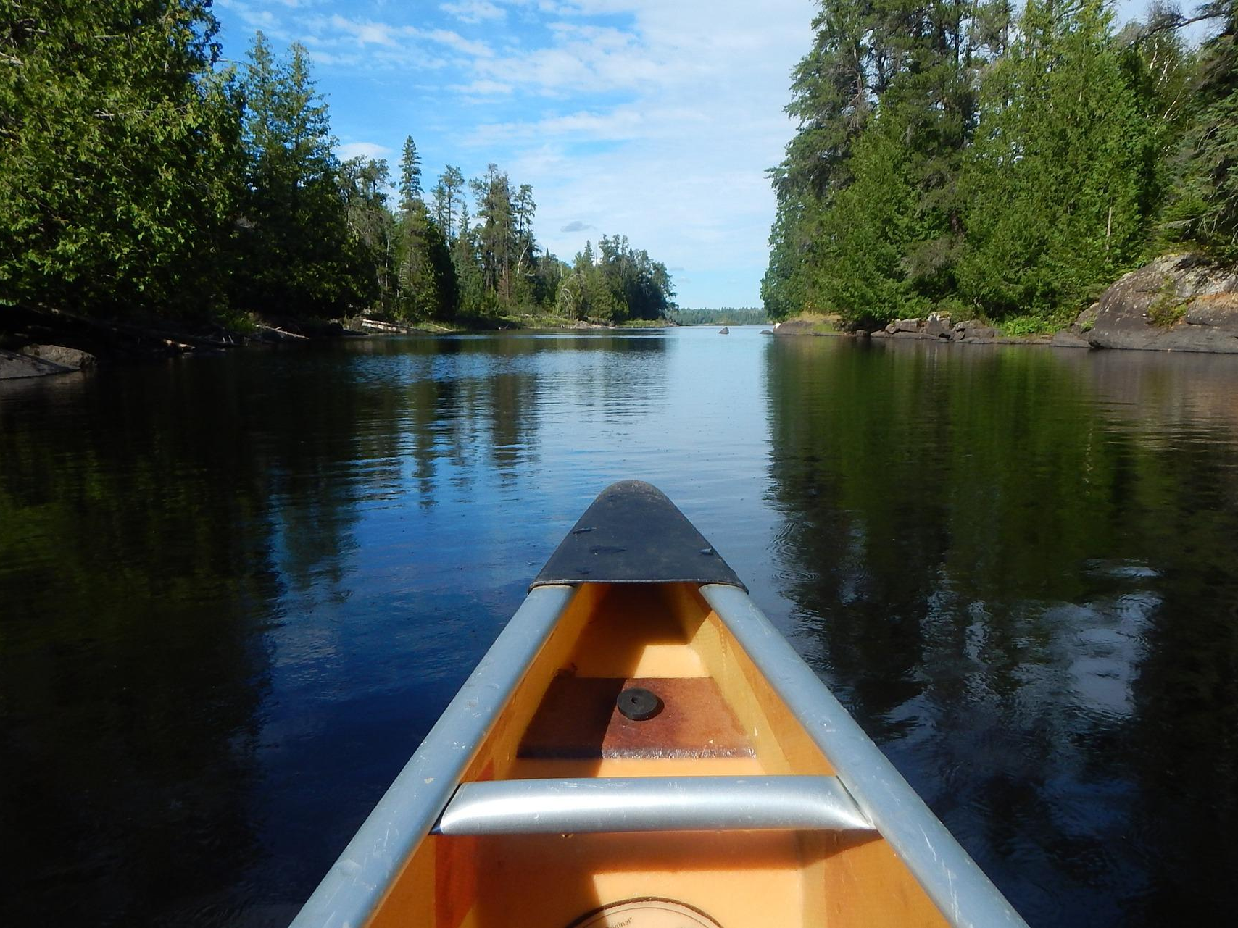
Conquer: the canoe challenge

Slide 3
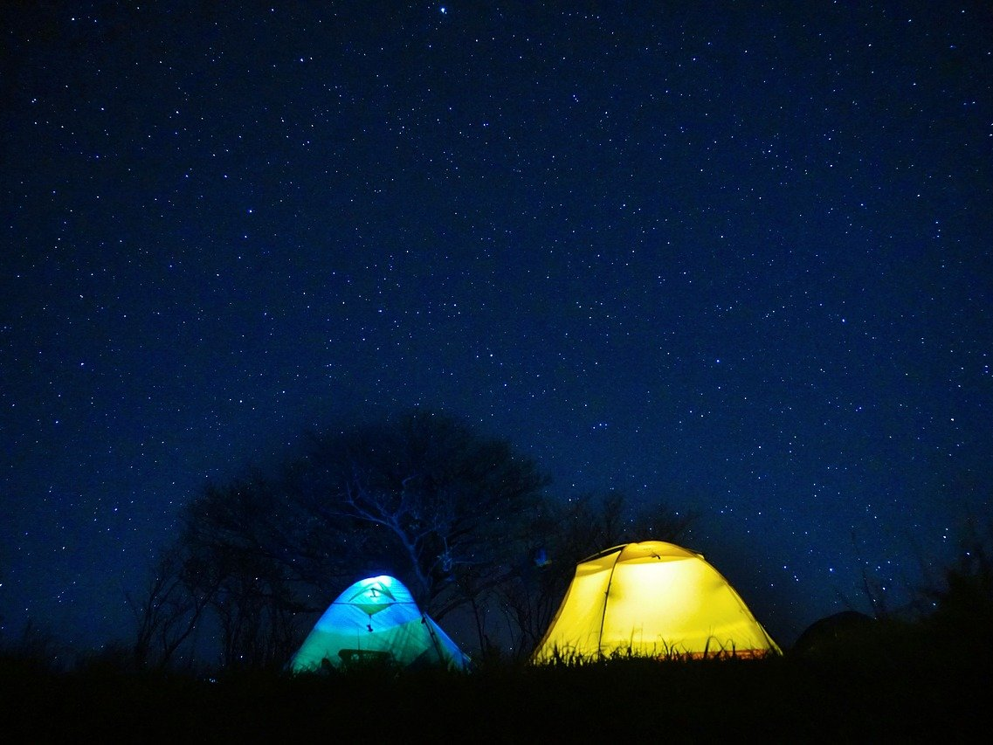
Embrace: adventure and expedition life

Slide 4
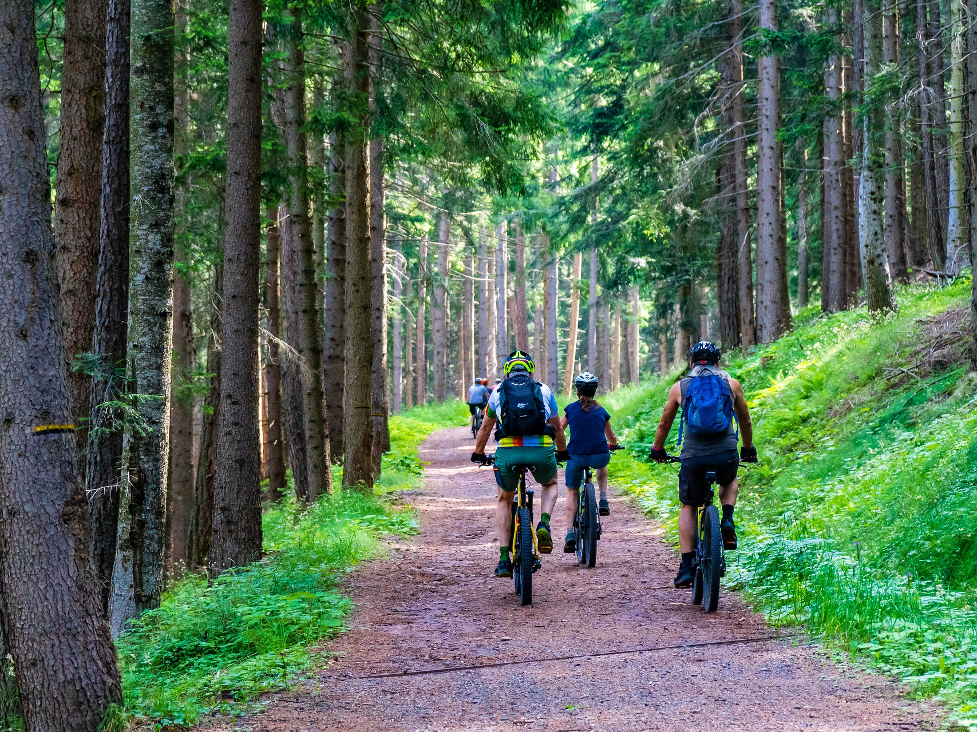
Pedal: Finland’s wild & natural Landscape

Slide 5
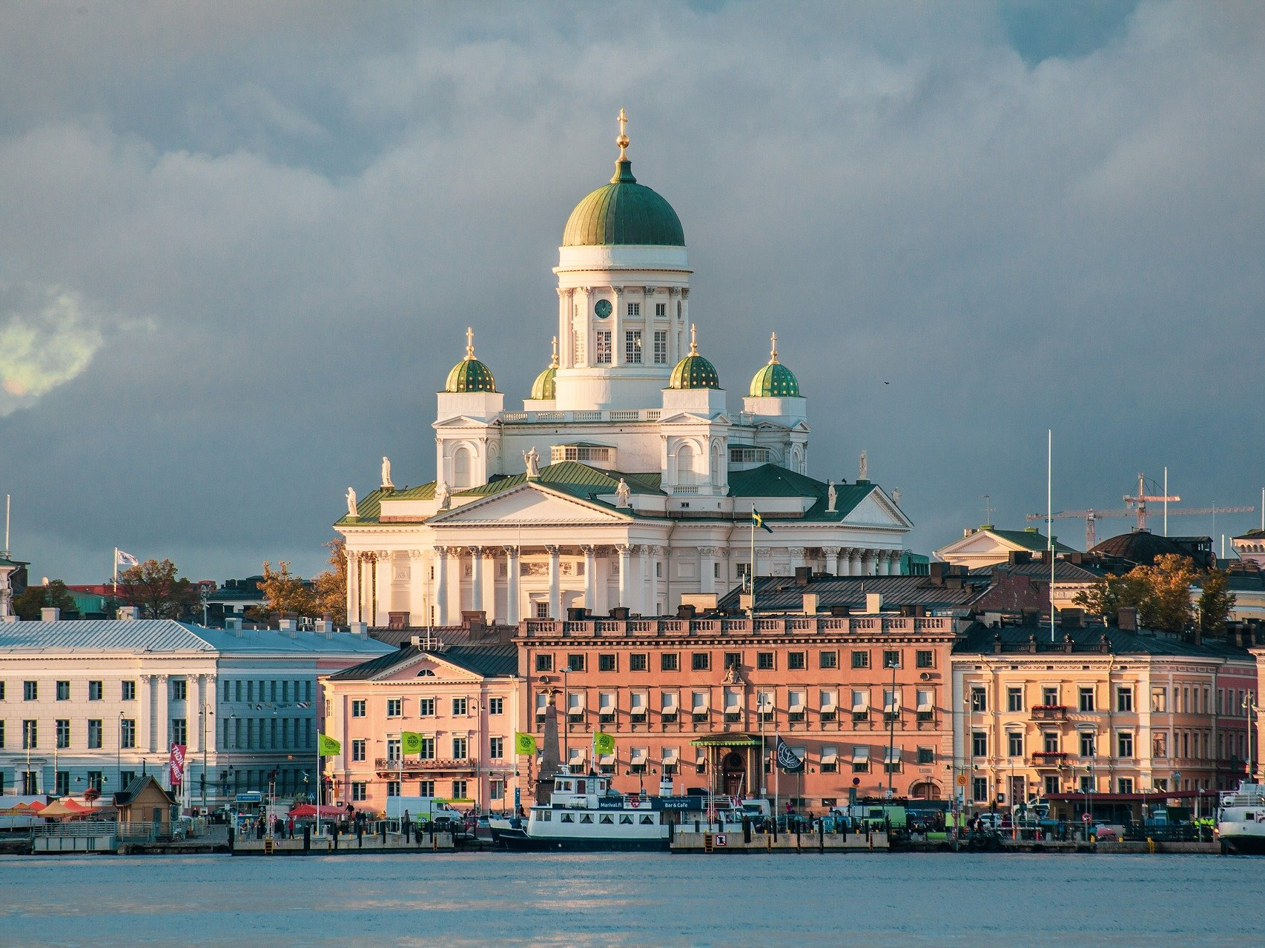
Discover: Finland’s culture & History

Slide 6
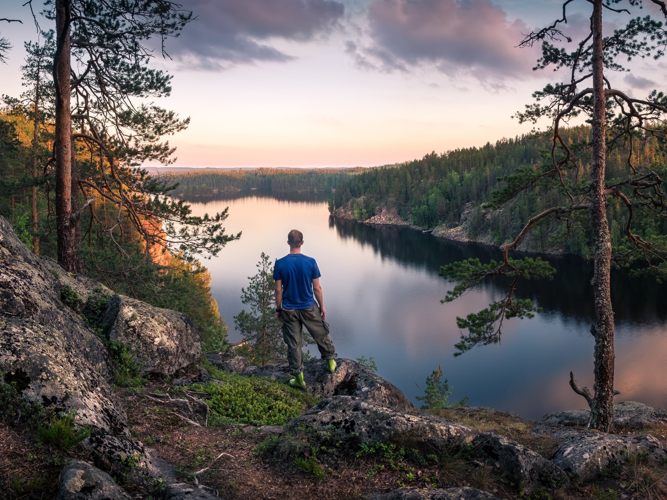
Join: the Expedition Team!

